Slide 1
Evaluation
Computational thinking

Slide 2
Objectives of Evaluation
Correctness: Does the algorithm return the correct results?
Efficiency: Does the algorithm run fast and use resources reasonably?
Robustness: Can it handle edge cases and invalid data?
Scalability: Does the solution perform well with large data or complex systems?
Usability / Practicality: Is the solution easy to use and deploy in real-world scenarios?

Slide 3
2. Principles of Evaluation
Principle of Measurement
Use metrics to assess results (e.g., runtime, memory usage, accuracy, error rate).
Principle of Comparison
Compare results with benchmarks, problem requirements, or other solutions (e.g., GTO baseline, best practice, previous version).
Principle of Feedback
Use evaluation results to improve algorithms, representations, or decomposition.
Create a loop: Evaluate → Refine → Implement → Simulate.

Slide 4
3. Evaluation Methods
Test Cases / Unit Testing
Test individual functions, modules, or components.
Include both edge cases and typical cases.
Benchmarking / Performance Testing
Measure runtime, memory, throughput.
Compare with other algorithms or previous versions.
Simulation & Stress Testing
Run tests with large datasets, abnormal data, or real-world scenarios.
Visualization & Result Analysis
Use charts, heatmaps, or graphs to analyze trends, errors, and sensitivity.
User / Stakeholder Feedback
In real systems, collect user opinions on results, usability, and effectiveness.

Slide 5
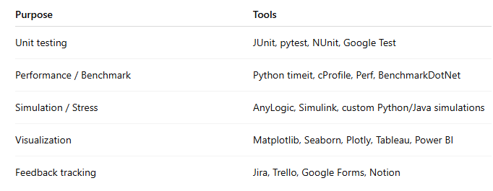
4. Tools Supporting Evaluation

Slide 6
Potential issues

Slide 7
1. Confusing Asymptotic Complexity vs Real-World
Judging only by Big-O and ignoring constant factors, cache effects, or implementation overhead.
An O(n log n) algorithm with huge constants can be slower than a “slower” O(n²) one on real data.

Slide 8
2. Measuring Only Runtime, Ignoring Memory and Other Resources
Solution A is 20% faster but uses 10× more RAM → fails when scaled.
Forgetting I/O cost, network latency, GPU utilization, or power consumption.

Slide 9
3. Testing on Non-Representative or Biased Data
Only random inputs → misses worst-case patterns (already sorted, duplicates, adversarial inputs).
Real-world data often has clusters, seasonality, or locality that benchmarks ignore.

Slide 10
4. Sacrificing Correctness for Speed
Accepting heuristic/approximate solutions (99% correct) when 100% correctness is required (finance, medical, safety-critical systems).

Slide 11
5. Poor Statistical Validation of Benchmarks
Running benchmarks only 1–3 times → results fluctuate due to OS scheduling, GC, etc.
Failing to report confidence intervals or perform proper statistical tests.

Slide 12
6. Optimizing a Single Metric (Overfitting to One Goal)
Minimizing latency while destroying throughput, or maximizing accuracy while ignoring precision/recall on imbalanced classes.

Slide 13
7. Ignoring Scalability and Operational Costs
Works great on one machine but cannot be parallelized or distributed.
Forgetting cloud/GPU/hour costs, maintenance, or deployment complexity.

Slide 14
8. Subjective or Unquantified Qualitative Claims
“This code is cleaner/maintainable” without measuring cyclomatic complexity, bug rates, or onboarding time for new developers.

Slide 15
9. Confirmation Bias
You already like one approach → selectively collect evidence that supports it and ignore counterexamples.

Slide 16
10. One-Time Evaluation Without Re-Evaluation
Hardware evolves, libraries improve, data distributions change → a solution that was best in 2023 can become the worst in 2025.

Slide 17
11. Failing to Evaluate Multi-Dimensional Trade-offs
Almost no solution is best at everything
Speed
Memory
Accuracy
Simplicity
Cost
Security
Forgetting Pareto analysis or weighted scoring.

Slide 18
12. Ignoring End Users and Real-World Context
Fastest algorithm but terrible UX, or shortest path ignoring traffic lights/one-way streets → useless in practice.

Slide 19
Checklist
1. Is the solution 100% correct on all valid inputs? (correctness first)
2. Tested on real-world data + worst-case inputs?
3. Benchmarks repeated ≥10–30 times with confidence intervals?
4. Measured time, memory, I/O, cost, and scalability?
5. Trade-offs aligned with actual business/domain requirements?
6. Plan to re-evaluate periodically as environment changes?

